Slide 1
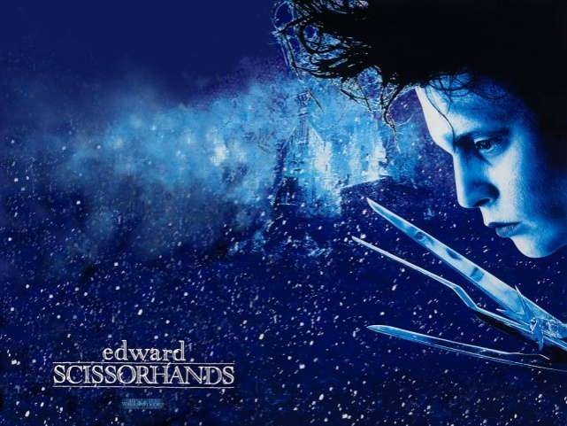
Close Study of Film
Edward Scissorhands

Slide 2
Language of Film
A close study of film entails a critical knowledge of how film is constructed and why. Identification and analysis of cinematography including : camera shots, angles, score, dialogue, mise-en-scene, lighting, motif, as well as themes, issues, ideas, audience, purpose and context provides us with insight into the way film is purposefully shaped to become a text type worthy of study.

Slide 3
Provenance
Released: 1990
Director: Tim Burton
Film Company: 20th Century Fox
Story by Tim Burton and Caroline Thompson (screenplay)
Score: Danny Elfman
Actors: Johnny Depp; Winona Ryder ;Dianne Wiest ;Anthony Michael Hall; Kathy Baker; Vincent Price; Alan Arkin

Slide 4
Definitions
Cinematography: The art or technique of movie photography, including both the shooting and development of the film.
Camera shots: the framing used by the director to construct a response from the audience. Includes : close, medium close up, mid shot, long, extreme close up, extreme long shot, conversation
Camera movement: tracking, dolly shots, transition shots, zoom
Camera Angles: eye-level, high, low, bird’s-eye; dutch tilt(slant)
Score: diagetic – sound that the actors and the audience can hear and non-diagetic: sound only the audience can hear
Lighting: key lighting, back lighting, spotlight, shadow, natural, artificial,
Dialogue: conversation – with other characters or direct address to the audience; voice overs

Slide 5
Viewing the film
As you view the film you should
enjoy the narrative concepts
Look for purposeful use of camera shots, angles, mise-en-scene, score, lighting and dialogue
Identify and record any major themes, issues, ideas or contexts

Slide 6
Links to Literature
Edward Scissorhands (1990) makes indirect allusions and pays filmic homage to the Gothic underpinnings of Mary Shelley’s Frankenstein (1818).
Read more about Tim Burton’s fascination with the Gothic here.
Edward Scissorhands has folk tale elements that align it with concepts in Beauty and the Beast, Romeo and Juliet and Pinocchio.

Slide 7
Themes, Issues and Ideas
Burton states that the key themes of the text are isolation and self discovery. Issues explored in the text are conformity, social acceptance, fear and segregation leading to the social rejection of outsiders, beauty is often evident in abstract forms, overcoming peer pressure and personal boundaries. A key idea in the text is the irony of rejecting a constructed being when we are all constructed, controlled and manipulated to conform and be accepted in society.

Slide 8
Deconstructing the film
The following stills will provide you with evidence of how film techniques are used to shape meaning. Your role, as a film analyst, is to evaluate their purpose and effectiveness. You will be provided with analysis sheets to workshop your ideas. Once completed, you should be able to deconstruct whole scenes and write discrete paragraph analyses of how and why the director has used film techniques to create specific effects. You should evaluate how the overall cinematic experience has impacted on the audience, insightfully challenging notions of identity, isolation and self discovery.

Slide 9
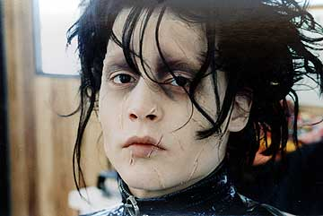
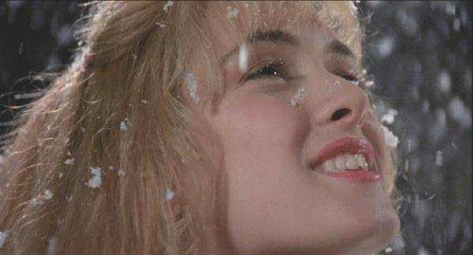
Camera Shots
Close up
Notes:
Close up shots: purpose: to engage/identify, highlight, focus, reveal, expose, determine, provide insight …..
Detail of character expressions
Emotional impact of events on the protagonist/antagonist
Characterisation
Sorrow, joy, loneliness, isolation, evident in facial gestures
Focus on eyes, zoom in to reveal inner pain/joy
Tilt of head, angle of camera, other effects can add to the meaning.
Front on or side angles
Extreme close up versus close up – extreme close up shows face or part of face only, close up usually shows head and neck
Used for revelation, inner understanding of character

Slide 10
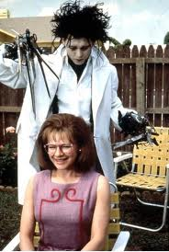
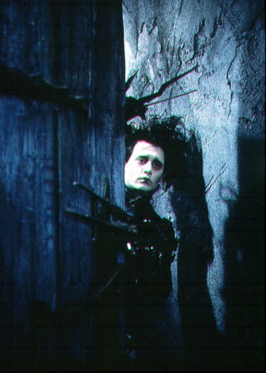
Camera Shots
Mid shots
Notes:
Midshots: purpose – allow for centrality, symmetry or asymmetry to reflect significance of character or setting focus.
Other techniques are usually evident: setting, colour, lighting influence the background and foreground, seated versus standing figures denote power or submission; symmetrical or asymmetrical mid shots suggest balance or imbalance to the tone of the scene; fear, darkness, shadowed areas reveal insight into characterisation but do so from a fuller perspective than a close up – see above, Edward reflects shadow, his fears, lighting used, gothic elements evident.
In the shot with Peg getting her hair cut, Edward has power, given to him by Peg. She is submitting to him willingly, note the contrast of colour; fence palings behind denote his new setting context; smile shows happiness and pleasure, intensity of Edward’s face suggests his commitment to creativity which is confirmed in the other hair cutting scenes. Garden chairs reinforce the 1950s middle class suburban context of the film.

Slide 11
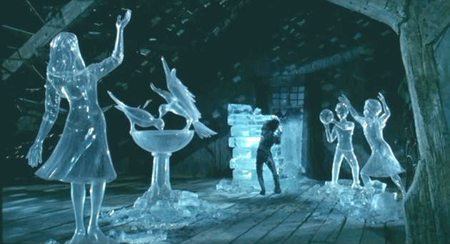
Camera shots
Extreme long shot, wide angle
Notes:
Extreme long shots deliberately convey scope of a scene allowing the audience to take in the bigger picture. Extreme long shots can incorporate wide angle lenses or fisheye lenses as with the suburban image above, providing a panoramic view allowing the audience to develop insight into the social context of the setting. Lighting is also used in the above image to show clarity and highlight the uniformity of the houses; the colours of the houses, muted and insignificant, denoting an unwillingness to challenge paradigms of society. Neat clipped lawns are seen into the distance.
In the ice sculpture long shot the viewer gets to see a range of images created by Edward suggesting his creatively and skill. Each image reflects meaning, the foreground image reflects his memory of Kim; the bird fountain his memories of the castle and the gardens he created there; the playing children are memories he has seen from the castle etc. As each image moves further back in the shot the viewer gains insight into Edwards memories and how they reflect his isolation. Visual archetypes – ice – frozen emotional space – idealise his inability to feel warmth and connection even amongst heartwarming imagery. His only way of communicating is through the beauty of his sculptures.

Slide 12
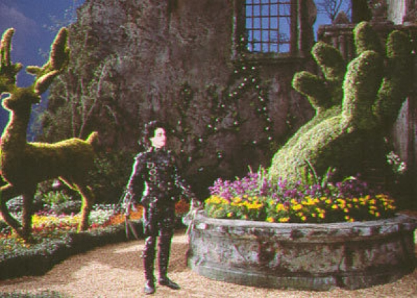
Camera shot
Long shot, symbolism
Notes:
Long shot shows Edward returned to his original status, living alone, isolated and entrapped by his black suit, amid a gothic scene. Provides overview, contextual information of personal context and genre – juxtaposition of gothic genre with romantic imagery of the flowering gardens, nature versus nurture arguments abounding in Gothic literature. The story of Frankenstein which influences this film was underpinned by the nature versus nurture debate: ability to create man but what responsibility is there to determining the values that shape the whole being. The crumbling castle in the background reinforces the gothic elements. These are juxtaposed in the midground by sculptures Edward has created amidst flowing gardens suggesting the values he has learned and adopted. The hand is symbolic – firstly of his maker, of being in the hand of someone who has create him with love – open hand; irony here however, as Edward does not have hands yet can create them when his creator has not yet had the chance to give him the hands he created for him. Suggests the symbolism of hands in archetypal imagery to guide, reflects open minds, support, willingness to help. The flowers reflect the colours of the world he has finally touched and provides his world with colour – a metaphor for growth.

Slide 13
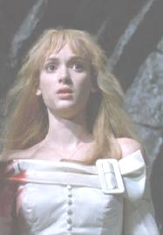
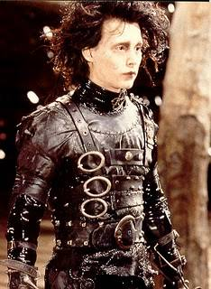
Camera shots
Mid shot, fade filter, costuming, colour contrast (white/black) as symbolism,
irony.
Notes:
Burton uses archetypal colouring in his direction of costume design. White is symbolic for purity and innocence whereas black is symbolic of evil. Burton however subverts these colour notions through the text. Edward’s black leather costume, a significant symbolic gesture to show construction; zippers and buckles substantiate his constructed identity; his tight, almost robotic, futuristic identity are sublimated by his obvious innocence and naivety. Kim, on the other hand, has not always represented the angelic being in white; she has previously lacked purity of soul and spirit, that is, until she meets Edward and undergoes a transformation. Burton’s use of mid shot and filters suggests she is not fully clear in her objectives, that she carries with her the shadows of her previous beliefs and values. Edward on the other hand is always in clear focus, no filters, the clarity is stark and at times confronting. The buckles on the dress echo the buckles on Edward’s clothing, the buttons the studs, a feminisation of Edward’s costuming. The echoing of costume, the contrast in colour and the juxtaposition suggest a deliberate alignment of the characters despite colour; they are a marriage of sorts, a renewal of spirit for each character.

Slide 14
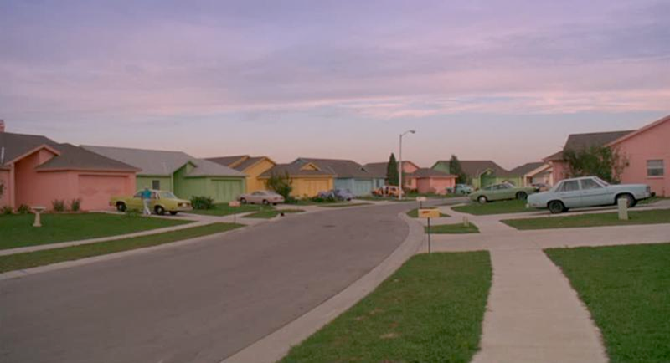
Camera shots
Panoramic shot
Notes:
Panoramic shot usually uses a fish eye lense to show the scope of a set, in this case allows the viewer to see the patterns of colour in the houses and the cars.

Slide 15
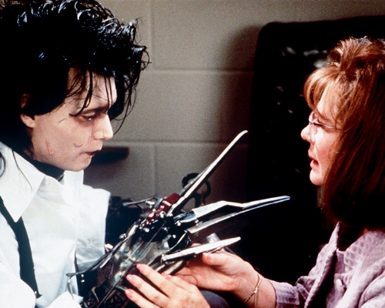
Camera shots
Conversation shot
Notes:
Conversation shots are usually filmed from the side; the characters, seen in profile are both equally represented on the scene. The focus on the head shots allows the viewer to appreciate the valuing of the conversation between the two characters.

Slide 16
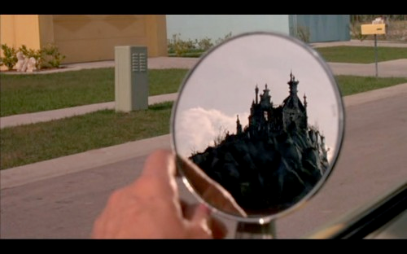
Camera shots
Mid shot, long shot, point of view, juxtaposition, genre, motif(mirror)
Notes:
The cleverness of this shot lies in its ability to provide insight into a significant message from this film, the need to reflect. The shot is used when Peg Boggs, as the Avon lady, is perusing the community for clients. The mid shot of her hand focusing the mirror, a motif used throughout the text to reflect on Edward and his self awareness, foreshadows the beginning of that change. In seeing the gothic structure the audience is challenged by the awkward juxtaposition it places in looking over the fairytale like suburb in pastel colours, also evident in this shot. The reflection reinforces the fable like qualities established at the beginning of the film…the Once Upon a Time qualities associated with castles. The dark and colourless castle is juxtaposed against the light of the community implying evil. The irony, however, is that the obverse is true, depending on the values and judgments made – so Burton effectively uses this shot to reveal prejudice – prejudging, based on appearances.

Slide 17
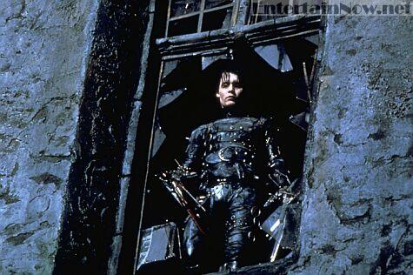
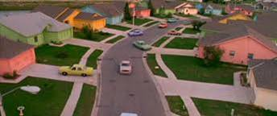
Camera angles
Low angle
Notes:
Low angles shots are used to denote power- in this shot Edward is seen at the window of the castle, surrounded by broken glass suggesting the decimated qualities of the building crumbling around his as his world is about to – so foreshadowing of events. Edward is looking down on the community – see inset. The shot shows him as fragile, fragmented ( literally and metaphysically) and yet, as the film progresses, shows him as having the moral high ground over the people of the community he sees below him. The view is of colour, a world he only sees and is perhaps later echoed in the colours of his garden. The completeness of the township is juxtaposed with the fractured nature of his current situation. The image presents a paradox- he is powerful morally, his heart, his morals, his kindness is far above all he sees below; yet, in his naivety he craves to be a part of a colourful world where he can find the colour of friendship and kindness, to be part of a community, to relieve his isolation.

Slide 18
Camera angles
High angle, panoramic shot, use of colour and setting.
Notes:
High shot, looking down identifies the point of view of the camera. The shot is a point of view shot from Edward’s eyes. The panoramic shot provides a full view of the vista below, the regularity of colour establishing setting for the viewer. The shot provides an almost omnipotent view, which, in the context of the film reflects Edward’s moral high ground.

Slide 19
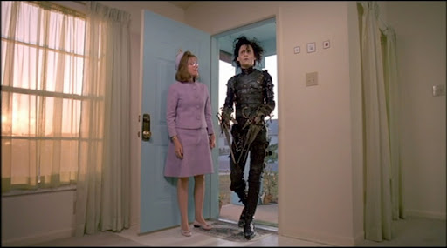
Camera angle
Low angle, mid shot, contrast, colour
Notes:
The low angle and centrality of the figures privileges their position in the scene. Both figures are placed in an environment that either accepts or rejects them based on colour. The contrast between the pastel mauves of Peg’s costume and the house and the ethereal qualities of the curtains reflects the equally ethereal morals and values of society. The stark contrasts with Edward’s heavily constructed, leather, tailored costume immediately denotes the audiences realisation of the struggles he will encounter in fitting in.

Slide 20
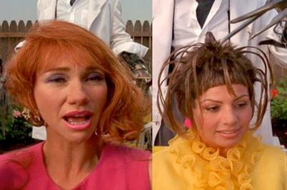
Montage
Notes:
A form of editing to allow the viewer to se multiple views at the same time – also evident in parallel editing. These images are a montage of the hair cutting scenes.

Slide 21
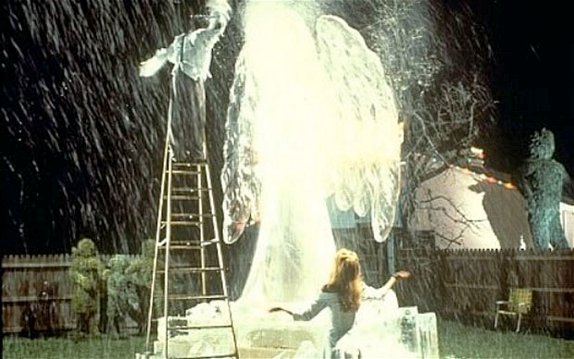
lighting
Notes:
Kay lighting is used to present desired outcomes and responses from the audience. The image of Peg entering the castle shows that light shines in from outside yet the interior only reflects a colourless, almost translucent quality - suggest unreality. The message is that the real world is beyond the walls of the castle.
In the ice sculpture shot the brilliant light gives the image a heavenly quality, echoing the angelic figure Edward is carving – the angelic figure is a representation of his love for Kim. The light reflects inner qualities and renewed focus and insight for himself. The lighting filters through the falling ice creating snow that symbolises cleansing of the soul and the spirit, a renewal for Kim. Snow becomes a motif in both the visual narrative and through the dialogue.

Slide 22
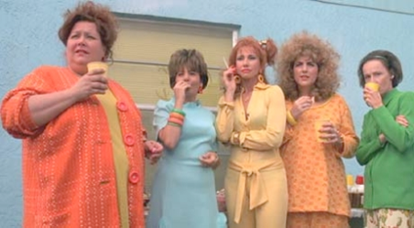
Visual motif
Colour
Notes:
Pastel colours are used as an aesthetic commentary on society. The blandness of the pastel colours of the costumes echo the pastel colours of the houses. The deliberate correlative links the inhabitants to the community and to the ‘pastel’ values it subscribes to… a bland colourless society afraid to break the conformity that maintains their acceptance of each character in keeping with their community.

Slide 23
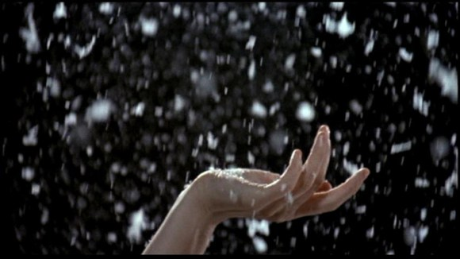
Visual Motif
Snow
Notes:
Snow is associated with Edward – the suburb/community has never experienced snow before Edward enters their world. Snow – symbolism of ice, rejection and Edward’s personal sense of isolation; the motif is used to highlight Edward’s creativity and demonstrates his ability to communicate the beauty of his soul and yet, paradoxically, remains rejected. The snow becomes a symbol of tranquility and adds to the fairytale and romantic qualities of the film, especially when Edward creates the ice sculptures of the family and of the angel – his interpretation of love. The ice sculptures are perhaps an attempt to show affection in an indirect and demonstrative way; he makes a statue of Kim as an angel, and she dances about in the “snow” that flies from it as he sculpts. Though he cannot connect with an individual on a reciprocative and empathetic level, he can still make affection known through an outward display of it. Though he cannot touch Kim directly without hurting her, he can “touch” her through the snow that falls upon her.
notes developed, adapted from
http://www.timburtoncollective.com/edwardpsycho.html

Slide 24
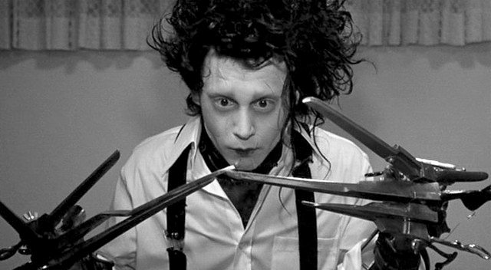
Symbolism
Scissors
Notes:
The character of Edward Scissorhands, reveals the allegorical nature of this film. The most obvious symbol is the set of scissors Edward has for hands. These represent his social faculties, and the difficulties they present to him. Throughout the film, Edward is shown to be greatly impaired when it comes to everyday activities, such as dressing, using eating utensils, or turning a doorknob. Edward is constantly cutting and scarring his own face accidentally; this scarring could represent the emotional scarring of failed social attempts caused by inability to subtly manipulate social situations.
While driving home with Peg, he reaches across with his hand to point at something, causing Peg to yell with distress. He is embarrassed afterward with his behaviour, once it is apparent he has done something wrong. His scissors actively impair him from becoming close to a person romantically; Kim Boggs asks Edward to hold him, to which he replies, “I can’t.” Ironically, his desire reveals his inability to reciprocate emotionally. The cleverness and insight into Edward’s emotional impairment is perhaps mitigated by the editing, where in the next scene, we cut back in time to a memory of Edward’s inventor dying before being able to give him the hands he needs to manipulate (or, in this allegorical reading, function socially). The ice sculptures are perhaps an attempt to show affection in an indirect and demonstrative way; he makes a statue of Kim as an angel, and she dances about in the “snow” that flies from it as he sculpts. Though he cannot connect with an individual on a reciprocative and empathetic level, he can still make affection known through an outward display of it. Though he cannot touch Kim directly without hurting her, he can “touch” her through the snow that falls upon her. Here, the scissors represent an as individual’s attempt to compensate for social deficit with other more advanced mental faculties.
Notes drawn from:
http://www.timburtoncollective.com/edwardpsycho.html

Slide 25
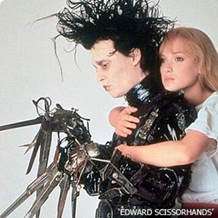
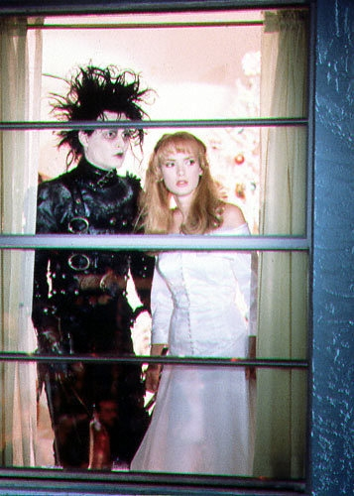
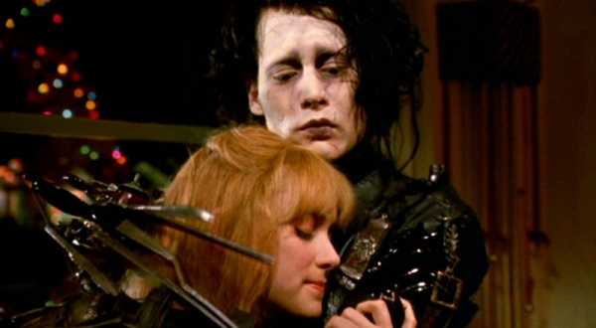
Literary Allusions
Romeo and Juliet
Notes:
Shakespeare’s narrative evident in the play Romeo and Juliet, itself and adaptation of folk story presents the concept of lovers who are destined to never be together due to stark differences in family background, politics or social acceptance. The same themes are evident in Edward Scissorhands. The imagery used each time the couple is seen in proximity once they have begun to love one another reflects the limitations and inevitability of their romance not coming to fruition. The increasingly dark imagery of the couple extends by the end of the film to being behind barred windows, bars and other barriers shut the couple off from the world highlighting the barriers and objections of society to their relationship. Shakespeare’s narrative ends with the lovers dying in the realisation that they can never be together. In this text death is symbolic rather than literal; they just retract and not see each other resulting in isolation for each character. Memories of the experience are all that remain. Kim tells the police that Edward is dead – the paradox is that the only way he can live is to be thought of as dead by the community and as such, be permanently removed from it.

Slide 26
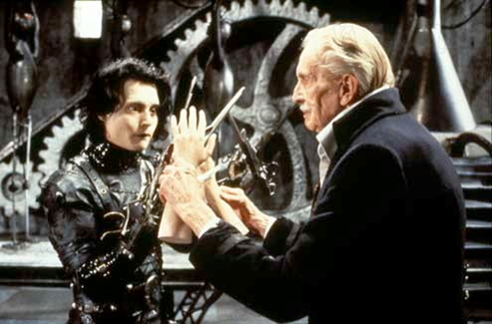
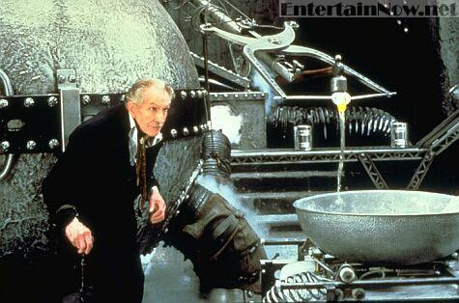
Literary Allusions
Frankenstein
Notes:
Mary Shelley’s Frankenstein or The Modern Prometheus belongs to the Gothic romantic period. The tale is of a young, adventurous student studying the arts of science to become a doctor who falls into the study of alchemy. Victor Frankenstein’s obsession with the origins of life reflect prevailing thoughts of the period in medicine, including those of galvanism – the giving of life through electromagnetic shock – the precursor of the defibrillator. As happens today with ideas about stem cell technology, cloning and other aspects of man being able to control the constriction, evolution and longevity of life through science, Shelley’s text focuses on the creator/creation dichotomy. Man, in terms of religious views, has not right to play God and the consequences for doing so will be dire. The rejection of the created being, firstly by the creator which occurs in Frankenstein (and a whole list of films created under that literary notion: The Island of Dr Moreau, The Hulk, The Boys from Brazil are just a few such films), then by society who are unable to accept the constructed being or the difference they represent. In Frankenstein Shelley focuses on the responsibility of the creator for the creation – in the case of Frankenstein, Victor, the creator, is so appalled by his being that he rejects him leading to a conflict that will lead to the destruction of soul and spirit of them both. Shelley is demanding mankind look at the reasonability of advances in science. She does, however, not claim to be making social commentary, rather claims her text is merely a ghost story, one of fantasy, that ultimately, in analysis, reflects the Romantic and Gothic paradigms of her literary milieu – the sublime and the picturesque, extensive creative imagination in the development of description of landscape, the fantastical elements of the narrative. Edward Scissorhands is subject to being such a creation, a created being constructed through synthetic means, his maker, with Pinocchio-like need, has created a son he can be proud of; the ‘father ‘ himself , is a seeming outsider from society and fulfilling a selfish need. The ‘son’ Edward loses his father in the process of construction, the final part of that constriction being his hands – the one aspect of our physiognomy that allows us to touch and connect physically with other humans. The lack of responsibility toward the creation due to the age of the creator is no less than that of Victor Frankenstein. As a result, Burton continues Shelley’s theme of personal responsibility for those notions of the construction and creation of life. Shelley’s text ends with the creature of Frankenstein’s making retreating to icy places, lands of devastating isolation where he cannot be rejected from the society he has learned to see as discriminatory and unaccepting. His rejection of his own soul and spirit at the relation of the rejection of his maker destroy him morally and spiritually. Likewise, Edward is rejected by a society that fears his differences. He retracts to the castle and becomes the figment of fairy stories and folk tales that have a moralistic tale as their coda. Both texts successfully challenge the audience to address the responsibility we have in terms of tolerating, respecting and having compassion towards humanity – regardless of race, creed, colour, deformity or origin.

Slide 27
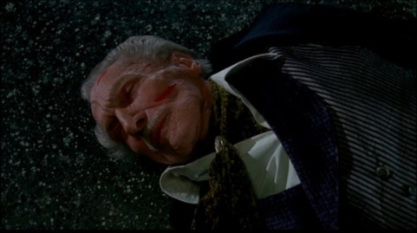
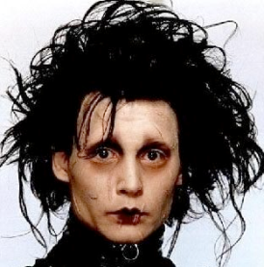
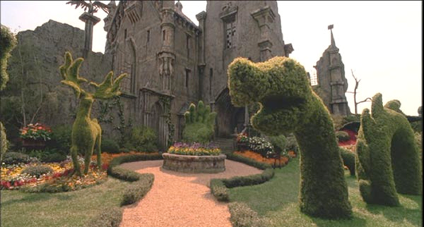
Genre
Gothic/Horror
Notes:
See the following website and test scenes of the film against the key elements of the Gothic genre.
http://www.virtualsalt.com/gothic.htm

Slide 28
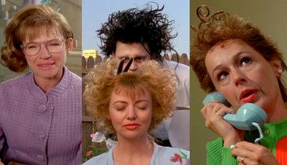
genre
Romantic; Satire; Fantasy
Notes:
The film reflects a range of genres. The romantic genre is evident in the relationship between Edward and Kim. The romance grows from conflict and rejection into one of acceptance and privileges an awareness of acceptance of difference and seeing the inner person, rejecting the idea of visual attraction as being a limited view of the other. The Romantic genre- seeing love from nature and acceptance and reviewing ideas about the sublime and picturesque are evident in the relationship.
The satirical aspects of the film are evident in the adoption of acceptance, but with patronising consequences. Edward can be accepted only if he contributes, and makes the women different also; the asymmetrical hair-cuts and aspect of modernity and post modernity addressed in the hair styling for the women reflects the changing nature of society and the influence of difference, ultimately, however, the prevailing forces and values of society, the restrictions of the view of women by men and the need to once again conform begin to control the women. The paradox is rich – the 1950s America created by Burton, craves to be seen as the one who stands out amongst nations yet does so by assuring its citizens of uniform rights – at a time when racial prejudice, rights for women and rights for other minorities were distinctly challenged.
Fantasy. The use of magical realism in the film, the fantastical elements evoked through the creativity and wonderment of the sculptures, whether garden or ice, suggest the imaginative nature of Burton’s work. The concept of creativity and imagination, the need to extend the imagination of the viewer are all evident throughout the film. Fantasy asks us to challenge the boundaries of reality. The end of the film is a dire commentary on the limited imagination of society and its refusal to allow for difference.

Slide 29
Set construction
Notes:
The set is a suburban street in Tampa Florida. The houses all reflect the 1950s – 1960s growth of the suburb and reinforces the American Dream concept of everyone having equal right to own their own home. The houses were painted, in four colours, using a regular pattern: sea foam, dirty flesh, butter and dirty blue. The regularity of the pattern echoes the banal nature of the colours which in turn is an archetypal metaphor of the banality of suburban life embedded with its lack of willingness to step outside of the norms. The windows of the houses were replaced with smaller window panes to imply the limitations of the view of those who reside within, metaphorically suggesting the narrow-minded views of others . The set is deliberately satirising the notion of conformity provoking the thematic ideals of accepting difference. The sculptures created by Edward challenge the uniformity, add colour, shape, difference, and fantasy that confronts the reader with the lack of imagination of a world where these aspects have been negated in the pursuit of conformity and acceptance.

Slide 30
Dialogue
Dialogue trivia: Johnny Depp, as Edward, only says 169 words throughout the film. The lack of dialogue suggests Edward’s innate understanding of the importance of silence.

Slide 31
Score
The music for Edward Scissorhands was composed by Danny Elfman. The most remarkable aspect of the Edward Scissorhands score is its ability to tell Burton's story without the visuals. The album takes you on the journey of this fable with masterful precision, embodying the heart-wrenching emotions of Edward's discovery and downfall with thematic and choral elements never restrained.
http://www.filmtracks.com/titles/edward_s.html
Notes:
The social commentary of Edward Scissorhands speaks to the heart of any outcast, offering a stark glimpse of Vincent Price's final, suffering creation of horror thrust upon a "perfect" vision of 1950's suburbia. What Burton initially considered a limited reflection of his own difficulties "fitting in" during his teenage years became a reference point for ostracized youth everywhere, bringing audiences to tears in the process of pushing all the right sociological buttons. The fairy tale genre served both Burton and collaborating composer Danny Elfman well, the storytelling structure of both Edward Scissorhands and The Nightmare Before Christmas allowing for extremely tight parameters that helped the scores for both films tell the stories by themselves. For Elfman specifically, Edward Scissorhands further heightened expectations for the young, classically untrained composer. The score remains a powerful juggernaut in album sales charts two decades later, a common source for use as temp music and heavily influential in everything from live shows to television commercials. Its success remains slightly bittersweet in that the era would eventually reveal that the successive triumphs of Batman and Edward Scissorhands would not be equalled by the composer in any of the following years. Incidentally, both featured the orchestration work of Steve Bartek and the conducting of Shirley Walker, though the latter score was recorded in Los Angeles rather than London. While Batman appeals appropriately to classically oriented mainstream action collectors, Edward Scissorhands has special meaning for fans of Elfman's very specific early style of unconventional rhythms and unashamed harmony. The score is somewhat of an enigma, combining those two key elements of Elfman's early mannerisms and packaging them into one very serviceable score and album. It is one of Elfman's few scores (if not the only completely effective one) that balances the best of both the zany quirkiness of his earliest writing and the thematic enchantment of those that would follow. The most remarkable aspect of the Edward Scissorhands score is its ability to tell Burton's story without the visuals. The album takes you on the journey of this fable with masterful precision, embodying the heart-wrenching emotions of Edward's discovery and downfall with thematic and choral elements never restrained. In terms of the orchestral ensemble, not much is different from Elfman's previous scores, though a significant role is given to the celesta and other high-ranging struck percussion. The celesta specifically offers dual representation of both the innocence of the main character and the wintry setting, lending a music-box style to the score that accentuates the bedtime storytelling ambience. The piano, while an integral part of other Elfman scores at the time, is largely displaced by the celesta, though a few notable piano solos are registered (the opening of "The Final Confrontation" is an obvious reminder of Beetlejuice due to its piano thuds). The harp returns from Batman, leaving behind its grand flourishes for deliberate plucking that, along with the strings, helps the celesta set the score's delicate rhythms. Rowdy rhythms for brass and bass woodwinds explode in the relentlessly rhythmic "The Cookie Factory," serving as the score's only true direct reminder of the sharp wackiness of Pee Wee and Beetlejuice. Few brass solos have an impact on the score, though the longing trumpet performance at the end of the title theme performance in "The End" (among other instrumental techniques heard in that cue) would largely foreshadow the upcoming spirit of The Nightmare Before Christmas. The true heart of Edward Scissorhands, though, is provided by the boy's and women's choral ensembles that brilliantly carry the imaginative elements of story and are rarely absent for longer than a minute or two in the score. It was not unusual for Elfman to employ such choral shades in his scores of the time, but the performances by the Paulist Choristers of California for Edward Scissorhands are incorporated with skill not heard elsewhere in any score of the 1990's (by Elfman or otherwise). After learning about choral techniques on the job, Elfman layers the singers brilliantly, allowing portions to serve as counterpoint within the group in an effort to maximize the harmonic resonance of the combined voices. The adult choir is emphasized alone in the score at times, though the more ethereal performances clearly define the work. Elfman uses the combination of the chorus, celesta, and strings to explore two primary themes in Edward Scissorhands. While the original intent was to utilize only one of these ideas, both of them were demonstrated so well that Burton and Elfman agreed to keep both. The first is the obvious title theme provided in the credits. An overarching idea for Edward's journey, this light waltz swings with elegance over celesta and plucked strings as the chorus provides the primary wordless statements of fantasy (bracketing a woodwind interlude that serves as a sub-theme later in the score). This cue is fully reprised with the same instrumentation in "Etiquette Lesson" and "The End," with continuing, fragmented references in between. Despite the easy appeal of this theme, however, it takes a back seat to the score's unofficial love theme (more officially the "storytelling theme"), which yields the undeniable tragedy in the score. It is this melody, enhanced by simple but crushingly gorgeous harmonic counterpoint, that graces the score's two famous tracks, "Ice Dance" and "The Grand Finale" and presents the chorus in its most beautiful, yearning performances. Elfman teases you with this theme in "Storytime" and "Home Sweet Home," and he never allows the theme to come to a natural conclusion outside of the slowly fading departure in "The Grand Finale." In the aforementioned early cues, as well as "Ice Dance" and "The End," Elfman always finishes the theme (and cue) on a longing note, never returning to its grounding key and thus drawing out the score's tragic intent even further. The climactic choral majesty of "The Grand Finale" is a dazzling, magical experience and stands among the most powerful single cues of the digital era of film music. The score's darker side, dominating its second half, strikes the culture clash at the heart of the film's dark edge. Elfman utilizes medium drums and lighter "la-la" vocals to underline the pleasantly sickening nature of the somewhat timeless 1950's suburbia setting. The world of the "Castle on the Hill," in opposition to the silliness of suburbia, is the menacing and ultimately tragically frustrating core of Edward's upbringing and seclusion. Several of the more horrifying moments of the tale, heard in "Death!" and "The Tide Turns," recall troublesome ideas established by Elfman in the just previous Nightbreed. These cues are hardly weak, but in contrast to the surrounding beauty, they understandably merit far less attention. Like many of Elfman's earlier works, Edward Scissorhands has a few stand-out tracks of sheer wizardry or bizarre deviation that deserve specific mention. You can always tell when the composer gets in a mood for ambitious fun when he pulls out the tubas for a wild rhythm; that rhythm, along with the harshly muted brass of "The Cookie Factory," lead to a few playful performances by woodwinds in that cue that also foreshadow The Nightmare Before Christmas. The piano-led rhythm in "Ballet de Suburbia" allows the sax to lead a motif that, once the percussion lets rip later in the cue, mirrors much of the spirit of Elfman's famous theme for The Simpsons. A solo accordion in "Esmeralda" is a bizarre but short deviation. The most colourful cue is "Edwardo the Barber," and for those who grow tired of the score's overbearing choral performances of the two primary themes, this cue is a constant pleasure. A mock-tango rhythm with castanets underscores Edward's hairstyling talents, mutating the suburbia motif for perhaps the score's most relaxed moment. In the middle of this cue, however, is a hoedown style explosion for about a minute that actively underscores Edward's most frenetic styling sequence. During this minute, plucked strings and accordion establish an increasingly frantic pacing over which a solo violin works wonders with its precise western or even gypsy-style slurring. If the comically melodramatic conclusion to this sudden burst of energy can't invigorate you, then you're not a true Elfman fan. The Tom Jones song is an unfortunately downside to the commercial 1990 album; his voice and the style of the song may have been an attempt to mimic the 1950's atmosphere of the film, but its comparatively tinny recording quality is quite irritating. Artistically, Burton would have been better served by having a sensitive vocalist provide a song version of Elfman's love theme. The balance of the mix between chorus and orchestra in Edward Scissorhands emphasizes the chorus far more than Batman did, without losing any of the orchestral elements in the process. This masterful mixing was completely lost in Batman Returns yielding a terribly flat result. While much of the mainstream discontent with the Batman sequel's score relates to its total loss of ambition in favour of morbid darkness, you have to credit the lovely and wet mix of Edward Scissorhands for not only setting astronomical emotional expectations for Batman Returns, but daunting technical ones as well. The 1990 MCA Records album for Edward Scissorhands has always presented the score's most important 49 minutes in outstanding sound quality. One asset of the bloated, disastrous $500 set titled "The Danny Elfman and Tim Burton 25th Anniversary Music Box" and released by Warner Brothers in 2011, however, is the addition of seven bonus cues, four demo recordings, a new music box composition dedicated to Edward Scissorhands, and a variety of demo material written by Elfman for the late-2000's ballet based upon the movie. One of Elfman's greatest career disappointments has been his inability to collaborate with production of the ballet, his film scoring assignments interfering with the ballet's schedule. Eventually, the ballet was scored with adapted material from Elfman's original film score anyway, but given the number of new directions he takes in the wealth of demos written for the ballet and included on the 2011 set, one can easily hear his passion for this music. Of the material on the dedicated CD #4 in the 2011 set, the demos are the least interesting, though it should be noted that the "Ice Dance" synthesizer rendering is better than the majority of finished orchestral scores these days. In the seven bonus cues, "Housewives" extends the quirky accordion material while "Paperdoll" revisits the wild "Edwardo the Barber" violin solos. Both "The Tide Changes" and "Confrontation" are suspenseful filler cues, while "Paranoia" reprises the score's quietly sensitive side. All of these exist without choir, though the singers do return in the pretty but super-short "The Talk Show Shocker." The bonus cues close out with the pretty but also short love theme rendition in "Kim at the Mall." All in all, the additional material amounts to five minutes in length and would not detract from the score if placed chronologically in the presentation (as it should have been), but it adds nothing substantial either. Thus, the set is definitely not worth paying $500 for simply to access Edward Scissorhands music unless you are desperately interested in the ballet demos. Overall, there are few positive adjectives that could not be applied to this score. Its likely intentional snub by AMPAS for an Oscar nomination in 1990 remains one of the most recognized in the history of the award. Many collectors believe that Elfman, despite an incredibly productive career after this score, has never really captured Edward Scissorhands's essence of magic ever again. Whether he does or not, this score will forever be noted as a grand highlight of both his career and film music of the 1990's.
http://www.filmtracks.com/titles/edward_s.html

